Slide 1
SystemVerilog for Verification Introduction
Jinfeng.Huang
2017/11/13

Slide 2
What is SystemVerilog?
SystemVerilog is a hardware description and Verification language(HDVL)
SystemVerilog is an extensive set of enhancements to IEEE 1364 Verilog-2001 standards
It has features inherited from Verilog HDL,VHDL,C,C++
Adds extended features to verilog

Slide 3
Why SystemVerilog ?

Slide 4
Why SystemVerilog?
Constrained Randomization
Easy c model integration
OOP support
New data types ie,logic
System Verilog
Assertions
Coverage support
Narrow gap b/w design & verification engineer
Fact: UVM is replacing SV based verification in industry.
UVM=Structed SV. Knowing SV based verification helps understanding UVM based verification, else UVM feels like set of magic macros

Slide 5
Verification environment
Checks
correctness
Testbench
Verification
Environment
scenarios;
stimulus
Test(s)
Executes
transactions
Scoreboard
Generator
Ask trans from gen;
drive DUT signals
pin2tran;
protocol check
Driver
Assertions
Monitor
DUT

Slide 6
SystemVerilog Concepts

Slide 7
System Verilog Concepts
Data types :
logic w; // 4-valued logic, see below
bit b; // 2-state bit 0 or 1
integer i; // 4-state, 32-bits, signed Verilog-2001
byte b8; // 8 bit signed integer
int i; // 2-state, 32-bit signed integer
shortint s;// 2-state, 16-bit signed integer
longint l; // 2-state, 64-bit signed integer
int d[]; // dynamic array
int assoc[bit[63:0]]; //associative array
int q[$]; // queues
struct {bit[7:0} r,g,b} pixel;
typedef; // own defined type
enum; // enumeration type
class *_c; // class type
Explicit 2-state variables allow compiler
optimizations to improve performance
logic is has single driver (procedural assignments or a continuous assignment), can replace reg and single driver wire.

Slide 8
System Verilog Concepts
Enumeration:
enum <type> { list_of_enumerations } ;
Examples:
  enum {IDLE, BEGIN_XFER, WAIT_DONE, END_XFER} myStates;
  enum bit [1:0] { ZERO=0, ONE, TWO, THREE=3 } numbers;
  enum logic { YES=1, NO=0, NOTSURE=’x } answers;
  typedef enum logic [1:0] { success, warning, error} statusT;

Slide 9
System Verilog Concepts
Routines: Tasks & Functions
No begin end required
Return can be used in task
Routine arguments with sticky types
Use ref pass array into a routine

Slide 10
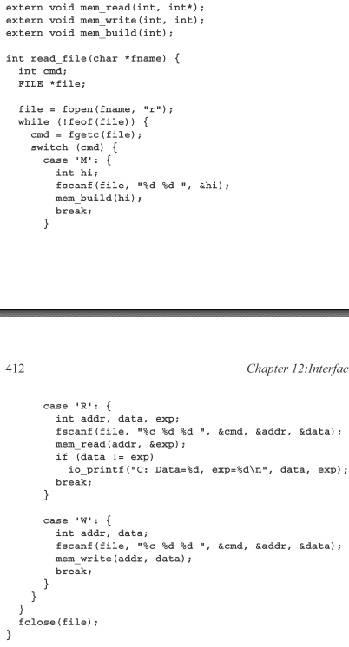
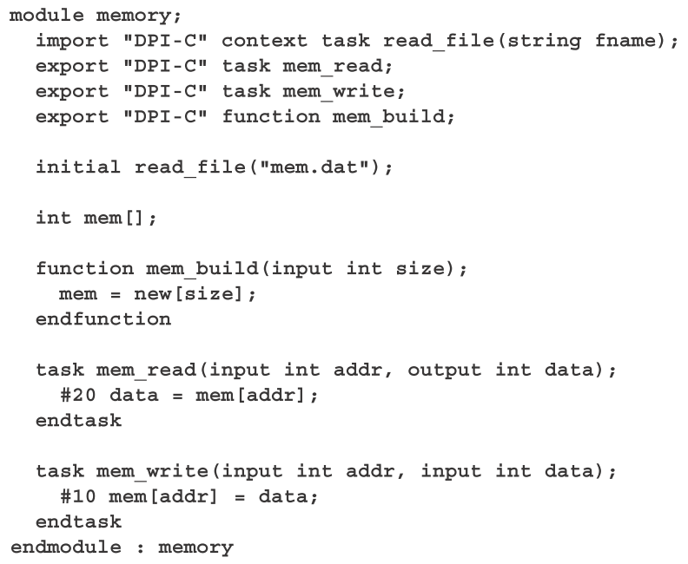
System Verilog Concepts
DPI(Direct Programming interface )
DPI’s are used to call C, C++, System C functions
System verilog has a built in C interface
Simple to used as compared to PLI’s
Values can be passed directly

Slide 11
System Verilog Concepts
Top SystemVerilog Testbench Constructs
Queue
Mailbox
Fork/join
Semaphore
Constraint randomize
Interface
Clocking Block
Code coverage

Slide 12
Queue…
Data storage array [$]
Variable size array with automatic sizing
Searching, sorting and insertion methods
Example:
ref_frame_q.push_back/push_front(frame_data)
ref_frame_data = ref_frame_q.pop_front()

Slide 13
Mailbox
Fifo with flow control
passes data between two processes
put() – stimgen calls put() to pass data to bfm
get() – bfm calls get() to retrieve data from stimgen
stimgen
bfm
mailbox
put()
get()

Slide 14
Mailbox
mailbox mbx;
mbx = new(); // allocate mailbox
mbx.put(data); // Put data object into mailbox
mbx.get(data); // data will be updated with data from FIFO
success = mbx.try_get(ref data); // Non-blocking version
mbx.peek(data); // Look but don’t remove
count = mbx.num(); // Number of elements in mailbox

Slide 15
Fork/join
Fork/join
Initial
Begin
Clk =0;
#5
Fork
#5 a = 0;
#10 b = 0;
Join
Clk= 1;
end
fork
Clk becomes 1 at t=15
join

Slide 16
Fork/join
Fork/join_any
Initial
Begin
Clk =0;
#5
Fork
#5 a = 0;
#10 b = 0;
Join_any
Clk= 1;
end
fork
Clk becomes 1 at t=10
Join_any

Slide 17
Fork/join
Fork/join_none
Initial
Begin
Clk =0;
#5
Fork
#5 a = 0;
#10 b = 0;
Join_none
Clk= 1;
end
fork
Clk becomes 1 at t=5
Join_none

Slide 18
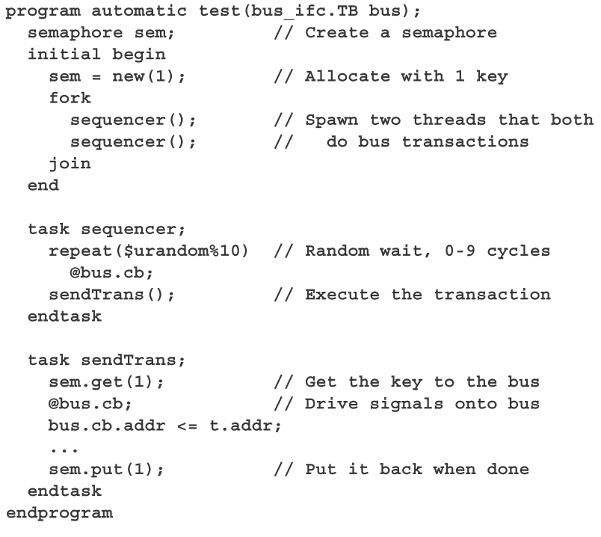
Semaphore
Used for Synchronization
Variable number of keys can be put and removed
controlled access to a shared object
think of two people wanting to drive the same car – the key is a semaphore

Slide 19
Constraint Randomization
Constraint randomization
Values for random variable can be controlled through constraint expressions
These are declared within constraint block
Class packet ;
rand logic [7:0] src;
rand logic [7:0] dest;
Constraint my_constraints {
src[1:0] == 2’b00; // constraint expression
…………… // always set src[1:0] to 0
}
endclass:packet

Slide 20
Randomization
Shift from directed to random
Directed
Random
Detect the expected bugs
Time consuming
Detects unexpected bugs (corner cases)
Tremendously reduce the efforts
More interesting cases can be achieved within the constrained boundary

Slide 21
Randomization
randomize()
  Every class has a built-in randomize() virtual method, declared as:
      virtual function int randomize();
  It is strongly recommended to check the return value of randomize function.
    Ex: assert(obj.randomize());
pre_randomize() and post_randomize()
  When randomize() is called,it first invokes the pre_randomize() then randomize() finally if the randomization is sucesusful only post_randomize is invoked.

Slide 22
Randomization
Constraint can be inherited and overwritten.
  class Base;
  rand integer Var;
  constraint range_1 { Var < 100 ; Var > 0 ;}
  endclass
  class Extended extends Base;
  constraint range_2 { Var > 50 ;} // Adding new constraints in the Extended class
  endclass
  program inhe_32;
  Extended obj;
  initial begin
  obj = new();
  obj.randomize(); // 100 > Var > 50
  end
  endprogram

Slide 23
Randomization
any SystemVerilog expression(>, <, ==)
Set Membership: inside {0,1,[50:60],[90:100]}
Weighted Distribution(randc are not allowed):
  := operator assigns the specified weight to the item or, if the item is a range, to every value in the range.
    Ex: Var dist { 10 := 1; 20 := 2 ; [30:32] := 2 }
  :/ operator assigns the specified weight to the item or, if the item is a range, to the range as a whole.
    Ex: Var dist { 10 := 1; 20 :/ 2 ; [30:32] :/ 2 }

Slide 24
Interface
bundling of port signals
provide an abstract encapsulation of communication between blocks
Increases the reusability
Timing (clocking blocks)
Functionality (routines,assertions and fc blocks)
DUT
TB
interface

Slide 25
Interface
Interface:An example
Interface bus_a (input clock);
logic [7:0] address;
logic [31:0] data ;
bit valid ;
bit rd_wr ;
Endinterface: bus_a

Slide 26
Clocking Block
Specify synchronization characteristics of the design
Offer a clean way to drive and sample signals
Generally declare inside interface
Features
Clock specification
Input skew,output skew
Cycle delay (##)

Slide 27
Clocking Block
Module M1(ck, enin, din, enout, dout);
input ck,enin;
input [31:0] din ;
output enout ;
output [31:0] dout ;
clocking sd @(posedge ck);
input #2ns ein,din ;
output #3ns enout, dout;
endclocking:sd
reg [7:0] sab ;
initial begin
sab = sd.din[7:0];
end
endmodule:M1
Signals will be sampled 2ns before posedge ck
Signals will be driven 3ns after posedge ck

Slide 28
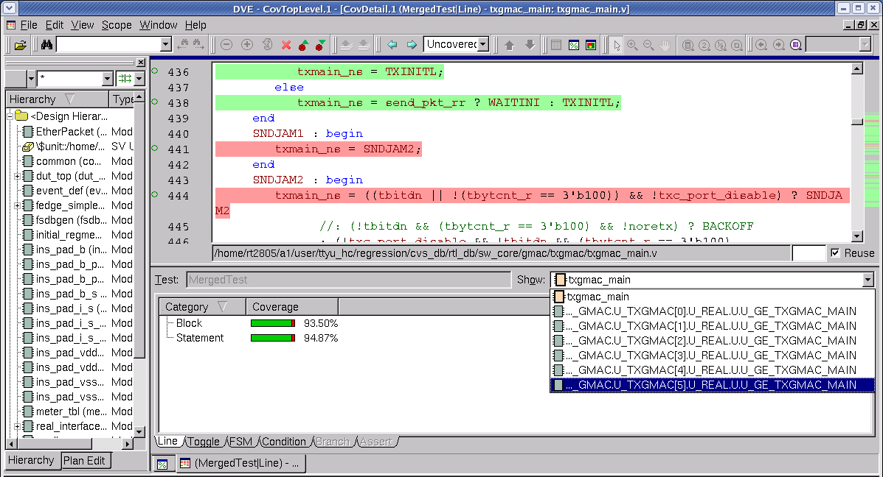
Code coverage: line coverage
Covered
Uncovered

Slide 29
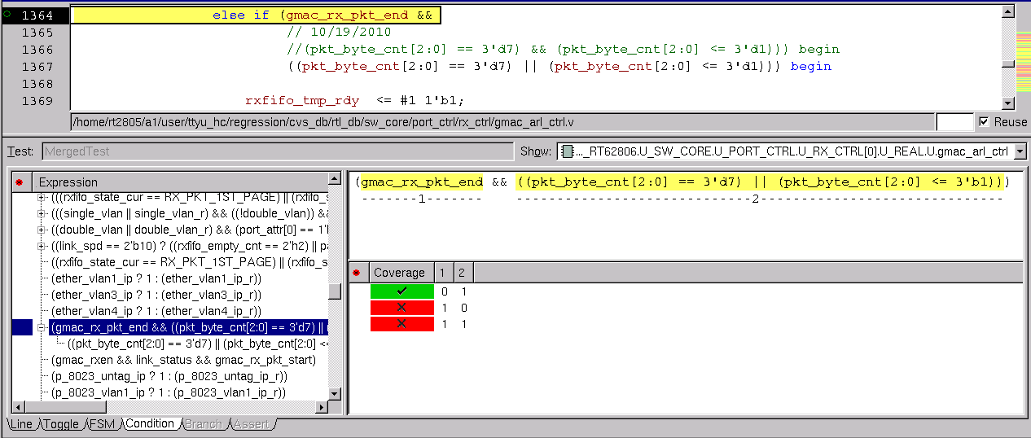
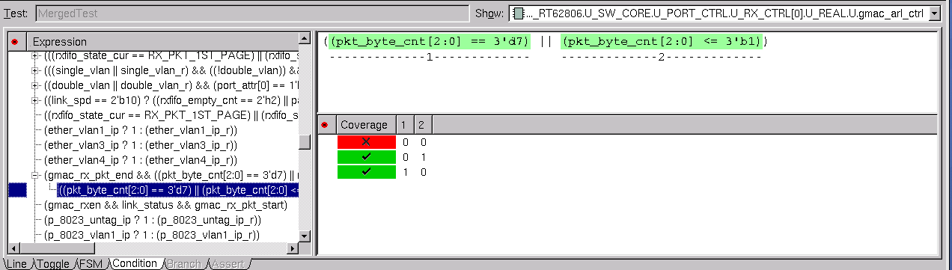
Code coverage: condition coverage

Slide 30
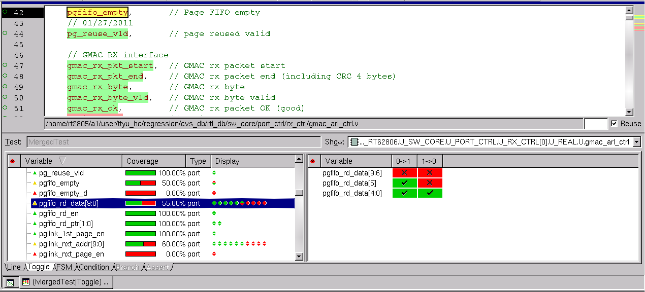
Code coverage: Toggle coverage

Slide 31
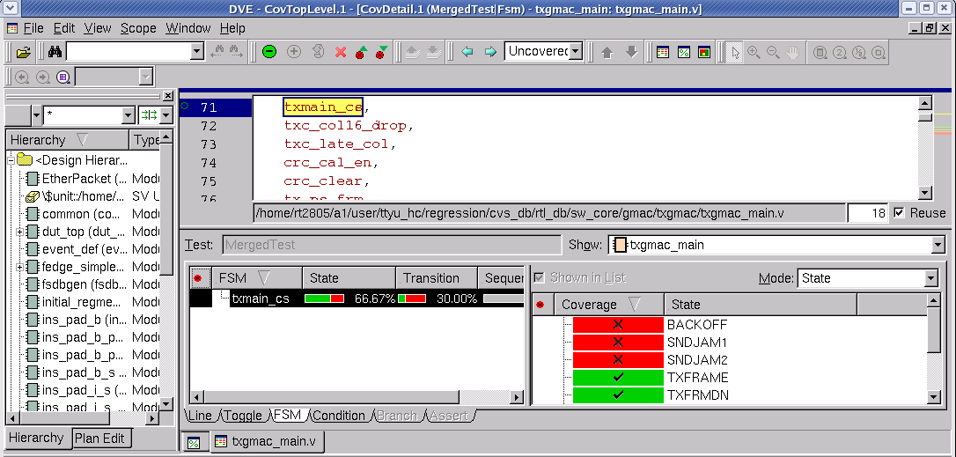
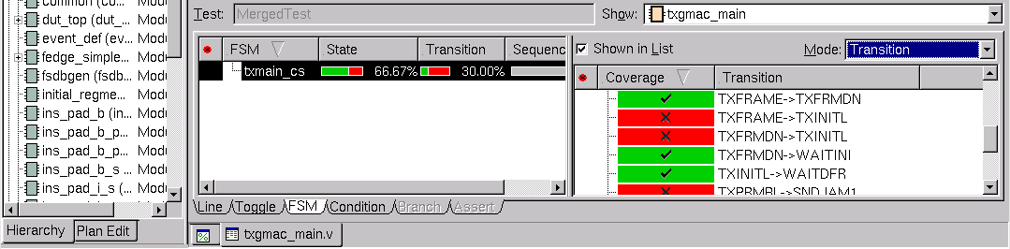
Code coverage: FSM coverage
Uncovered State
Uncovered Transition

Slide 32
OOP Concepts

Slide 33
What is OOP?
classes
encapsulation
OOP
polymorphism
inheritance

Slide 34
What is OOP?
OOP breaks a testbench into blocks that work together to accomplish the verification goal
Why OOP
Highly abstract system level modelling
Classes are intended for verification
Classes are easily reused and extended
Classes are dynamic in nature
Easy debugging, one class at a time

Slide 35
Why not C++
Why system Verilog?
Why Not C++?

Slide 36
Why not C++
C++
System Verilog
No relation to verilog
Interface is required to interact with Verilog
Superset of Verilog
RTL/Verification language
Assertion language
Constraint language
Code coverage language

Slide 37
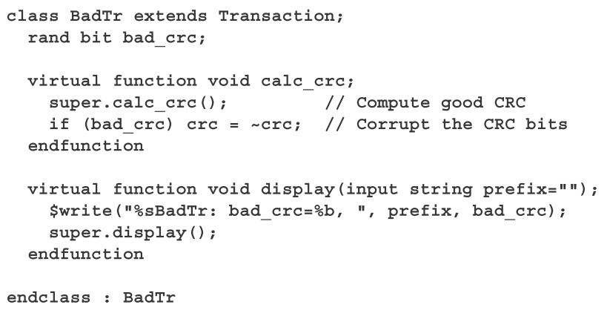
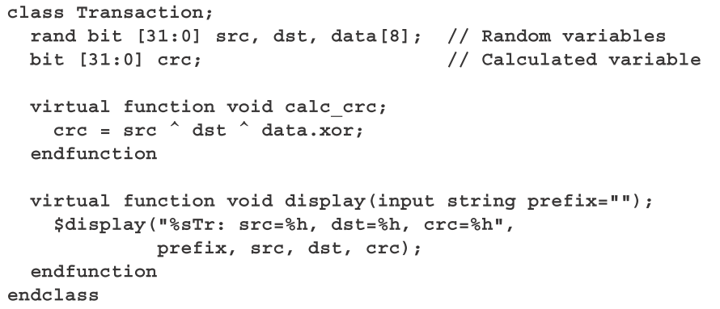
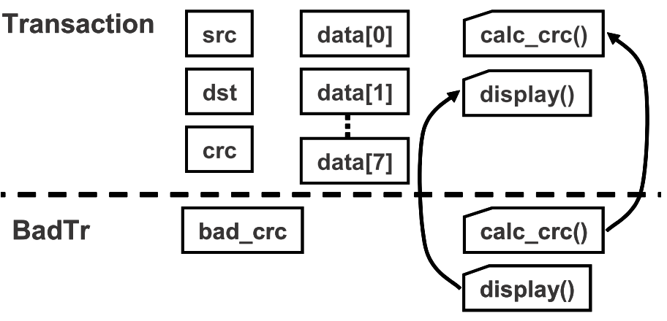
Inheritance

Slide 38
Inheritance
Advantages
Common code can be grouped into one class
No need to modify the existing classes
Add new features to existing class by means of new derived classes
Easy debug & easy to maintain the code base

Slide 39
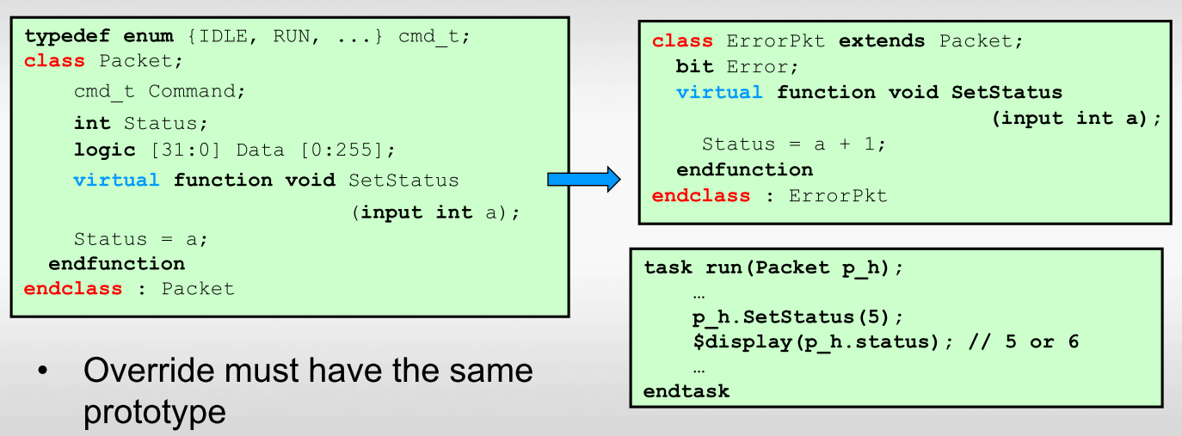
Polymorphism
Ability to have the same code act differently for different types
A key requirement for any OOP language
Statically at compile time by using parameterized types
Dynamically during run-time using virtual class methods

Slide 40
Materials
Websources:
1. www.systemverilog.org
2. www.asic-world.com/systemverilog/index.html
3. www.verificationguide.com/p/home.html
Books :
1. Writing Testbenches using SystemVerilog
- Janick Bergeron
2. Verification Methodology Manual
- Janick Bergeron
3. SystemVerilog For Verification
- Chris Spear

Slide 41

Waiting for ...
Topic on TB based on SystemVerilog
Topic on SVA and Function coverage
Topic on UVM
Topic on TB based on UVM

Slide 42
Q&A
Thank you

